Slide 1


Slide 2


Introduction
This project aims to analyze the sales data of a large store to identify key patterns and trends in financial performance.
The analysis will provide insights and recommendations to improve marketing strategies and operational efficiency, while also understanding how different segments, cities, and product categories contribute to sales volume.

Slide 3
Data cleaning.
*Identifying and Handling Missing Values*: We examined our dataset for any gaps and used technique where necessary.
2. *Removing Duplicates*: Ensuring that no repeated entries skewed our analysis.
3. *Correcting Errors*: Fixing any inaccuracies in the data, such as spelling errors or incorrect dates.
4. *Normalization and Standardization*: Making sure all data points followed a consistent format, especially for units of measurement.
5. *Filtering Out Outliers*: Detecting and managing to avoid misleading conclusions.
Through these steps, we transformed raw, messy data into a polished foundation ready for insightful analysis.

Slide 4
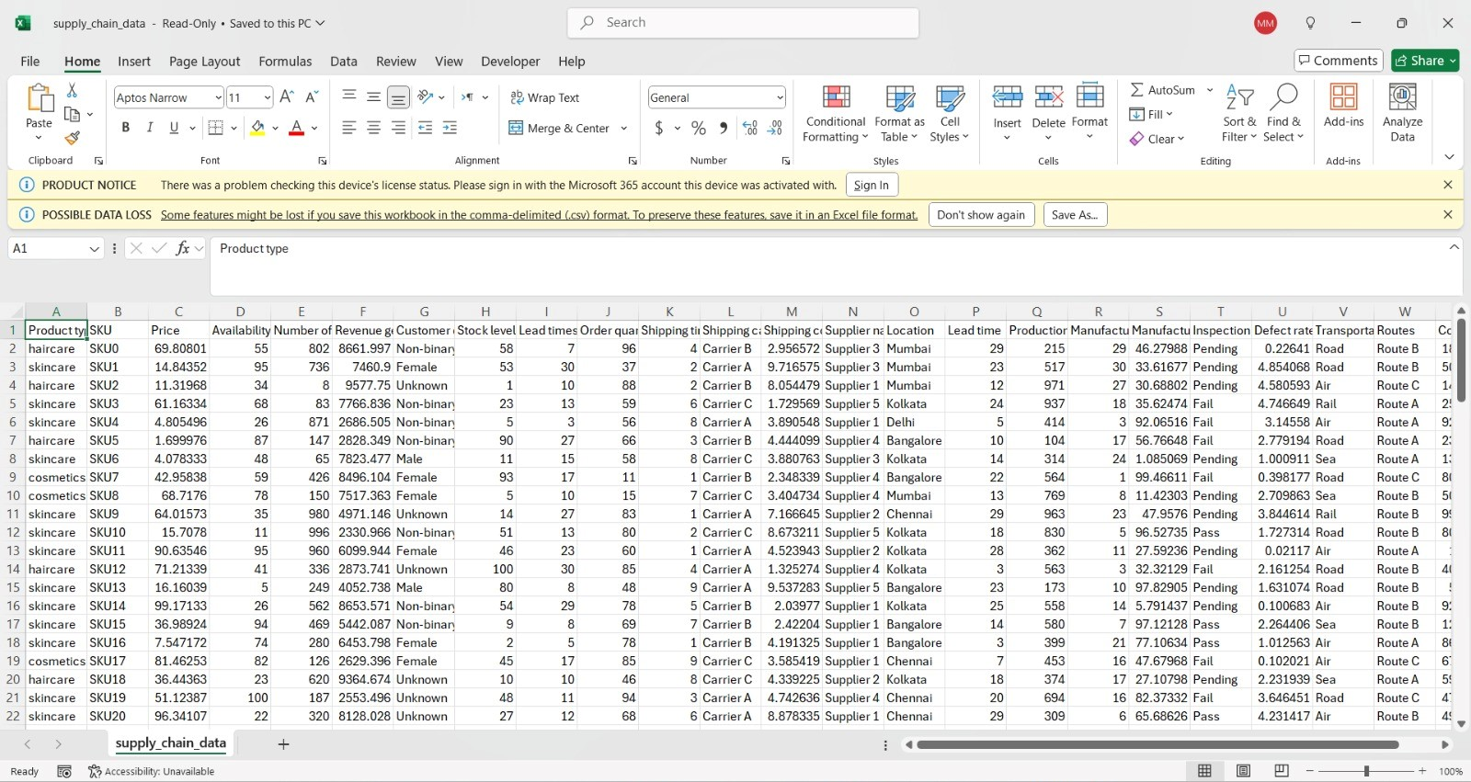

Slide 5
Data Exploration
1*Exploratory Data AnalystPerform exploratory analysis (EDA) to understand initial patterns in data.
2* Use charts to examine sales distribution by category (Furniture, Office Supplies, Technology).
3*Analyze performance by geographic region (East, West, Central, South).Prepare group reports on preliminary results.

Slide 6
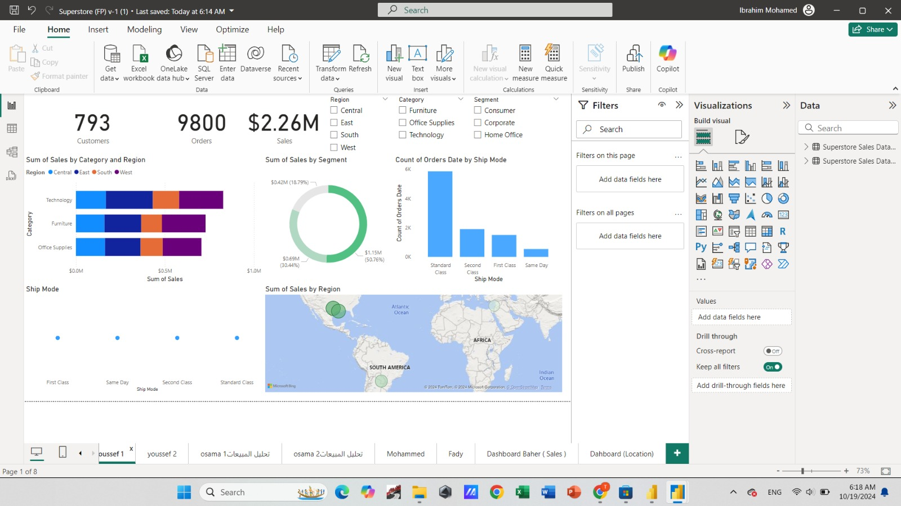

Slide 7
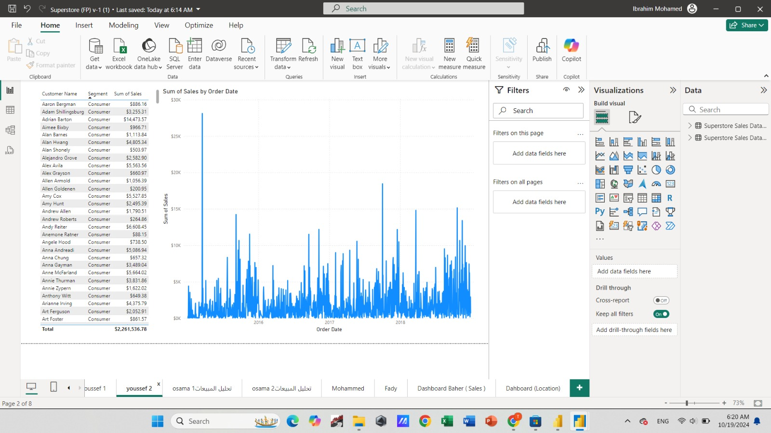

Slide 8
Sales analysis for category and sub category.
• Top-Selling Products and Revenue Trends.
• Geographic Sales Performance.
• Sales analysis by region and shipping services.

Slide 9
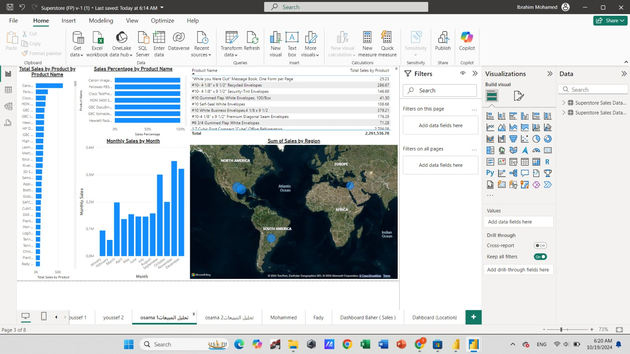

Slide 10
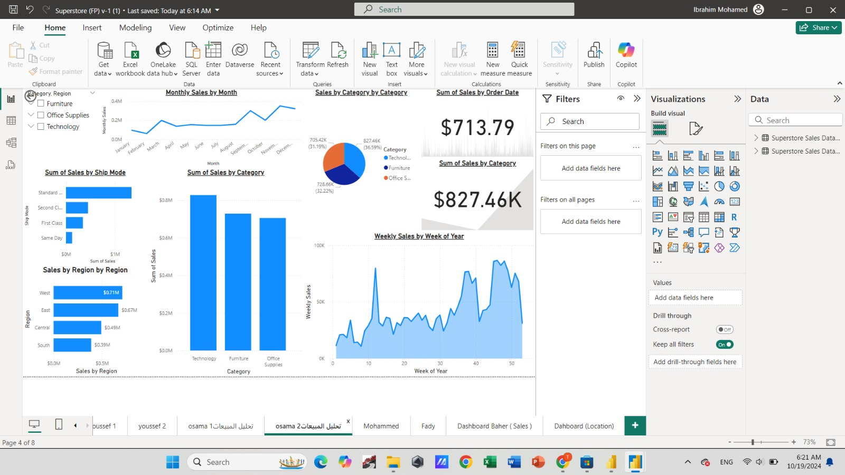

Slide 11
customer data analysis
*Analyzing Customer Data*: - Understanding purchasing behaviors by analyzing data such as age groups, cities, and states.
2. *Analyzing Demographic Impacts*: - Studying the impact of demographic factors (like city or state) on purchasing decisions.

Slide 12
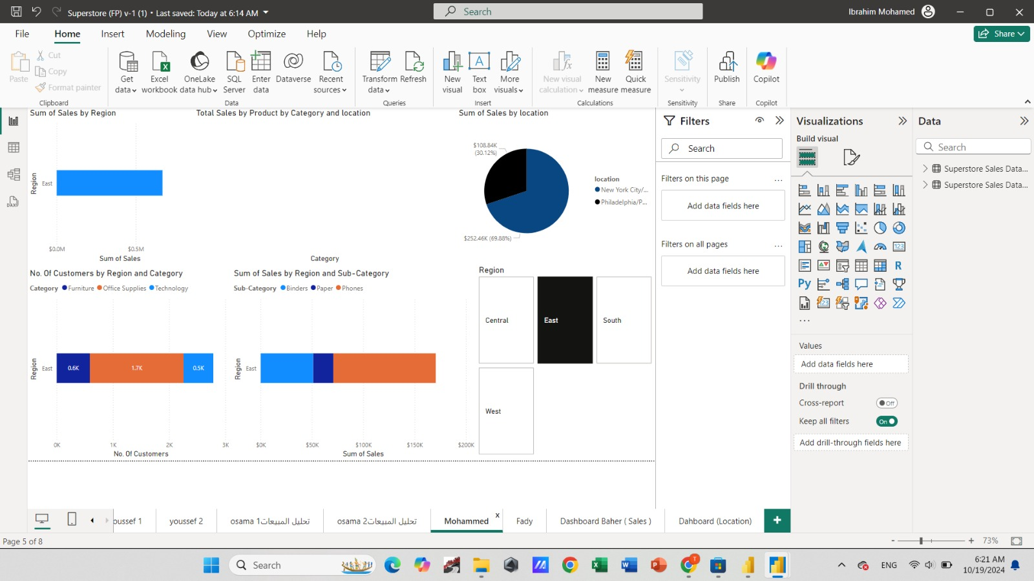

Slide 13
Logistics and Shipping Analysis:
1*An analysis of shipping performance was conducted by calculating the count of order dates relative to ship dates across different cities.
2* The total delivery time was aggregated by year, quarter, month, and day to identify temporal patterns.
3*Additionally, the sum of delivery time per city was measured to uncover regional inefficiencies, and delivery times across different shipping modes were evaluated to assess their effectiveness.
4* insights supported the development of recommendations aimed at improving logistics operations and enhancing shipping efficiency.

Slide 14
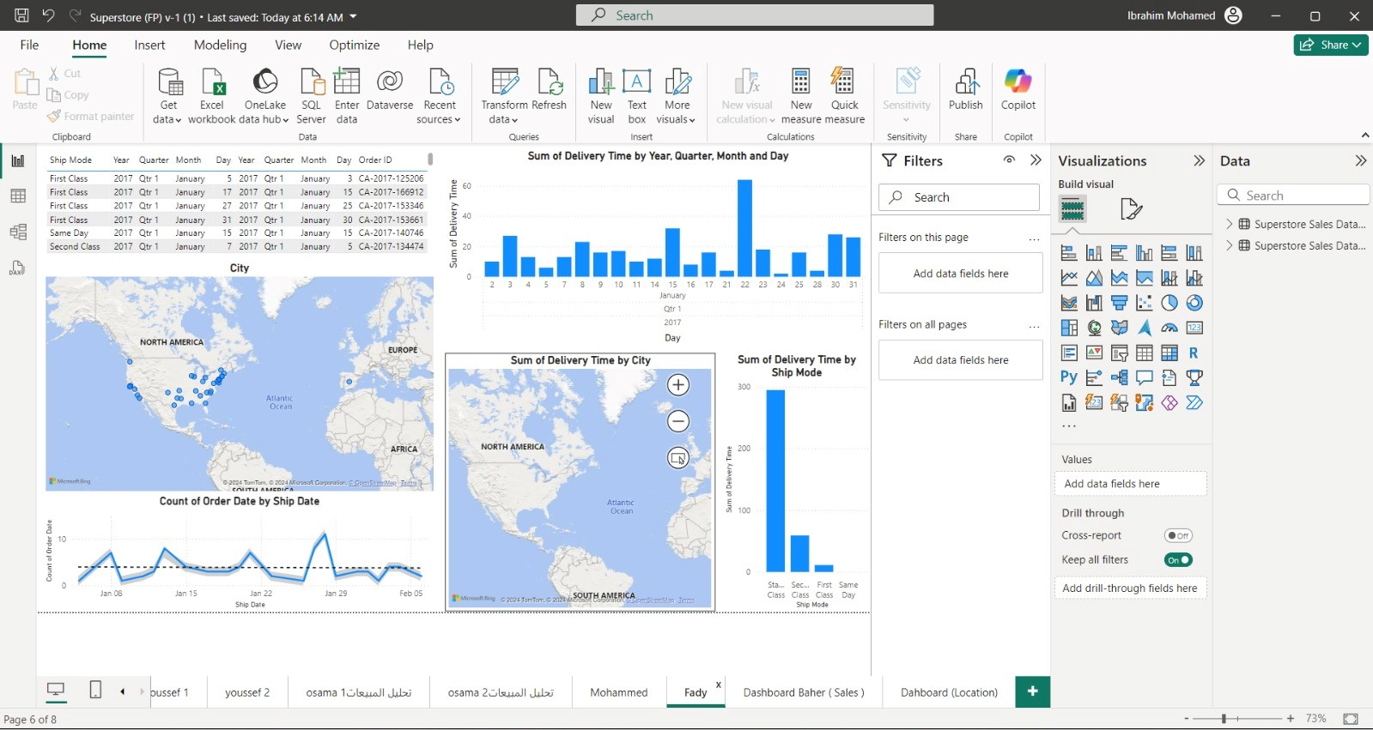

Slide 15
Dashboard for executive summary Part 1 of sales.
Part 2 by location and sales share in regions.

Slide 16
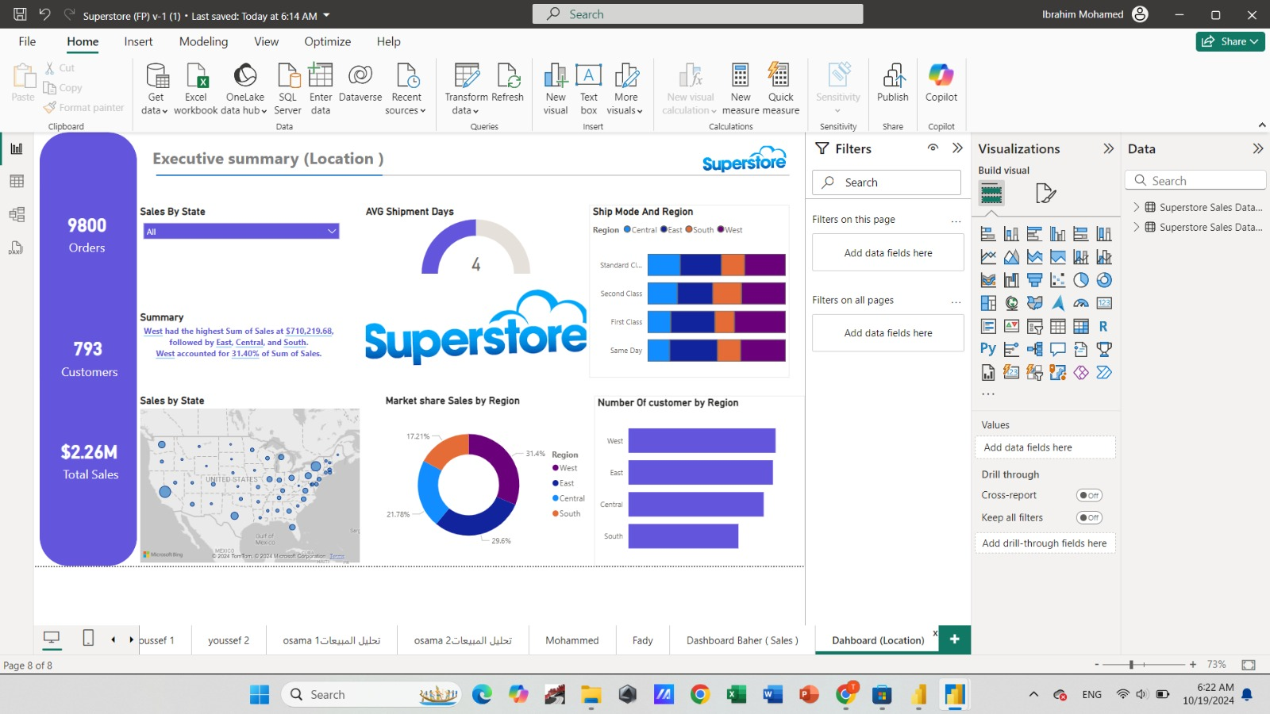

Slide 18
Thank You

